Slide 1
KELP
Project Apex
Investment Opportunity
Strictly Private & Confidential – Prepared by Kelp M&A Team

Slide 2
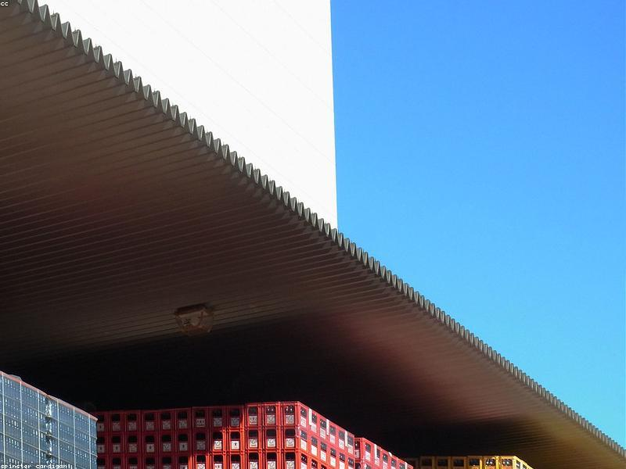
KELP
BUSINESS PROFILE & INFRASTRUCTURE
■ The company operates express model screens and signature/luxuriance models.
■ Franchisees bear capital expenditure for the expansion strategy, with ongoing marketing support provided by the entity.
Strictly Private & Confidential – Prepared by Kelp M&A Team

Slide 3
KELP
FINANCIAL & OPERATIONAL SCALE
■ Revenue From Operations increased significantly from 2022 to 2023 and further in 2024, then slightly decreased in 2025.
■ Operating EBITDA peaked in 2024 after significant increases since 2022 before a slight decrease in the following year.
Strictly Private & Confidential – Prepared by Kelp M&A Team

Slide 4

KELP
INVESTMENT HIGHLIGHTS
■ The company has received orders with customer and value details, including duration.
■ Capacity or production figures are not mentioned for the entity's operations.
Strictly Private & Confidential – Prepared by Kelp M&A Team

Slide 5
Disclaimer
This presentation is strictly confidential and is being provided to you solely for your information. By accepting this presentation, you agree to keep it confidential and not to distribute it to any other person.
This document does not constitute an offer to sell or a solicitation of an offer to buy any securities. The information contained herein has been obtained from sources believed to be reliable but is not guaranteed as to accuracy or completeness. Project Apex and Kelp M&A Team make no representation or warranty regarding the accuracy of the information.
This presentation may contain forward-looking statements that involve risks and uncertainties. Actual results may differ materially from those projected.
Strictly Private & Confidential – Prepared by Kelp M&A Team

